Slide 1
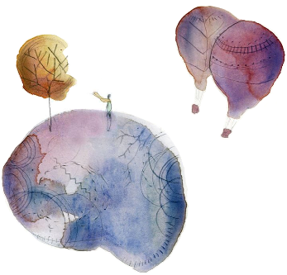


Exploring brain dynamics to characterize Alzheimer's disease
Rotary Club of Tanjong Pagar , October 26 - 2016
Raphaël Liégeois, PhD

Slide 2
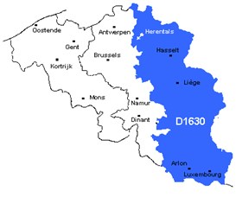
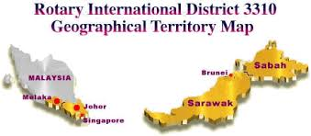

Who am I ? Why am I here ?
Rotary Foundation Scholarship for the project: “Exploring brain dynamics to characterize Alzheimer's disease”.
District 1630
District 3310

Slide 3

Belgium

Slide 4
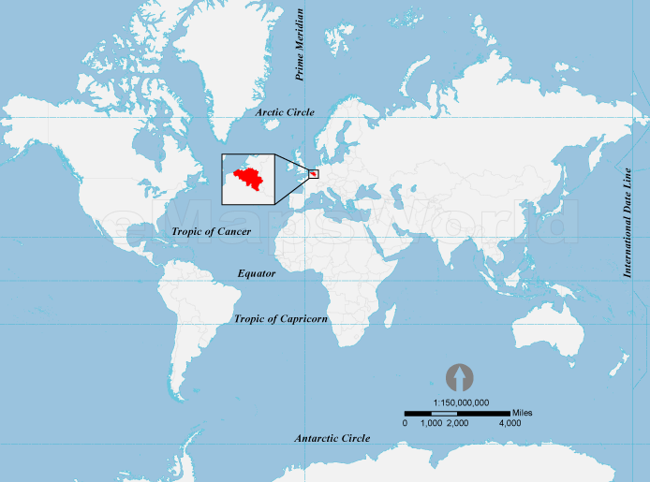



Belgium
And Liège…

Slide 6
Introduction: Alzheimer’s disease
Key facts
First described by Dr. Alois Alzheimer in 1906
Alzheimer's disease is a chronic neurodegenerative disease that is the cause of 60% to 70% of cases of dementia (World Health Organization).
Alzheimer's disease affects 50 million people in 2015.
Alzheimer's disease is poorly understood but deterioration of brain anatomy and function are assumed to be crucial.

Slide 7
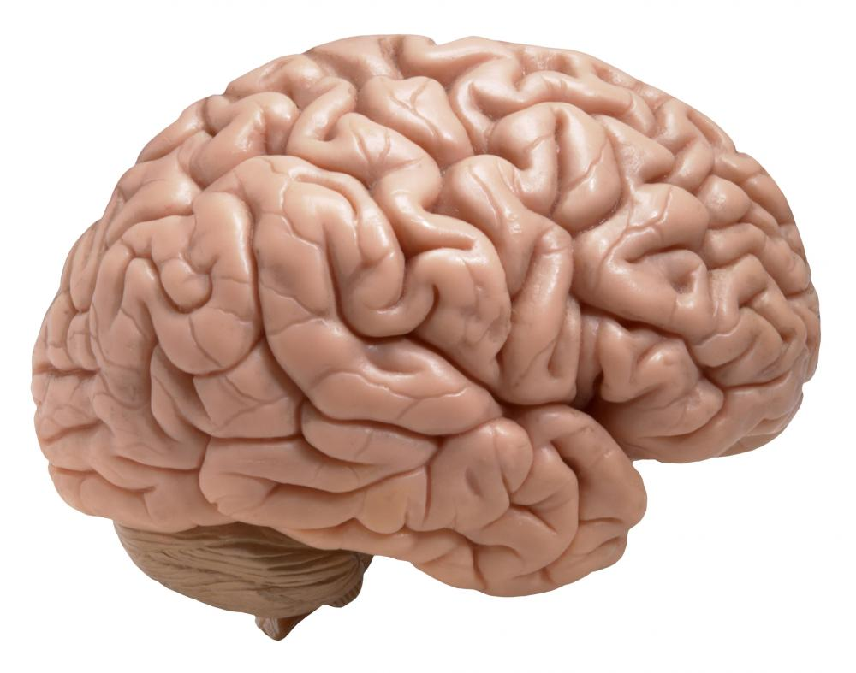
Introduction: functional information
Functional data (e.g. fMRI, EEG)
Functional connectivity (FC)
“Statistical dependence between two time series” (Friston, 2011).
FC matrix
Intensity in different ROIs
ROIs
Classically measured by the correlation between time series.
Time
ROIs

Slide 8
Static vs. dynamic approach
“Static” approach
“Dynamic” approach
Signal in different regions
Signal in different regions
How does FC(t) influences FC(t+1) ?

Slide 9
Example of marker δ applied on Alzheimer patients
δ
MARS score
There is a significant correlation between δ and the MARS score
First time anosognosic AD patients could be distinguished from conscious AD patients based on fMRI data

Slide 10

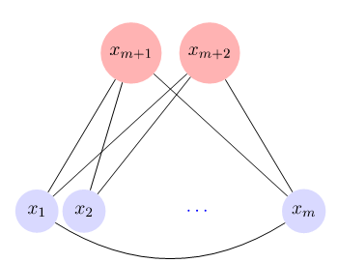
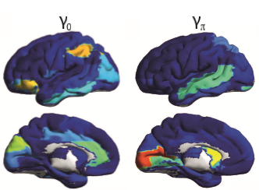
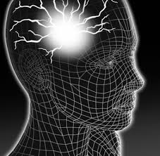
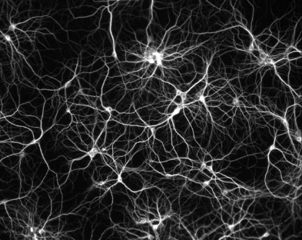
An overview of my projects
→ How can we include this dynamical information in different analysis frameworks ?
Dynamical Component Analysis
Dynamical Markers of FC
Prof. T. Yeo
Link to diseases
Bridge between neuronal and brain scale dynamics

Slide 11


Thank you

